Slide 1

PaperLessGMP^{R}
By Cyclone Pharmaceuticals Pvt Ltd
Developed by GMP Software Pvt Ltd

Slide 2

What is Paperless GMP^{R}
Pharmaceutical industry till now is working with Paper Documentation. Paperless GMP is giving you opportunity to implement Digital Documentation, Digital QMS, Digital Process, and other operations, Its just not a ERP Its PaperLess GMP.
Notes:
GMP?: system ensure that product are consistently produced and controlled according to quality std. designed to minimize the risk,
Till now all the documentation done manually, all documentation use paper form , hand written specially in pharma industry. So, paperless GMP is giving opportunity to implement

Slide 3

Who are Promoters
Cyclone Pharmaceutical Pvt. Ltd. India’s Leading GMP and Regulatory Consultant has identified Digitalized future of pharma industry and need of a comprehensive software for Pharmaceutical Manufacturers with advanced technology support from expert technocrats of GMP of Software Pvt. Ltd.
Notes:
So with growing futures and established documentation system, CPPL has decided to move one step forward towards digitalization and developed a software. Since many years CPPL is taking efforts to develop such software, and made this one stop platform which will really take care of all your departments. It is a dream project of team CPPL.

Slide 4

Dream Project
The Dream Coming to reality, CPPL team got Success to take all Pharmaceutical Manufacturing Activities and Documents in digital form, its Now exists as PaperLess GMP
Notes:
It is validated GMP software, and have in built quality system

Slide 5
Advantages and Benefits
Perfection and Accuracy
GMP and QMS needs perfection, Accuracy and Quality PaperLess GMP Delivers the same
Zero human error System
Backed up with Incident reporting and Deviation Management at every stage
Highest Security, Validated modules, Access control
eBMR with complete process flow
All modules covered
Notes:
Aim of our software is to deliver quality, in terms of Perfection and Accuracy bcoz gmp and qms needs……..0 human error- human mistakes, organizational weaknesses
It is an unexpected or planned variation from any approved procedure, system or established standards

Slide 6

SIX ‘P’ GMP concept
People
Premises
Products
Processes
Procedures
Profit
We takes care of these 6P’s in PaperLess GMP so Seventh is Paperless GMP^{R}
Notes:
While GMP is a large & complex topic, the practices can be summed up in the following 6 p…….All people involved in making a drug must have clear roles & responsibilities………The premises and equipment must be properly maintained & cleaned…….. Standard methods must be followed for packing, testing & sampling of the products…………Processes must be clearly defined, consistent and evaluated.

Slide 7
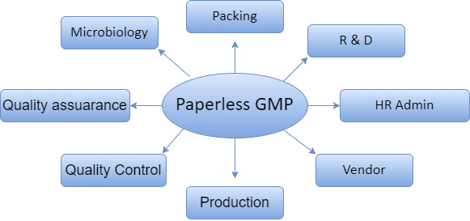
Modules

Slide 8
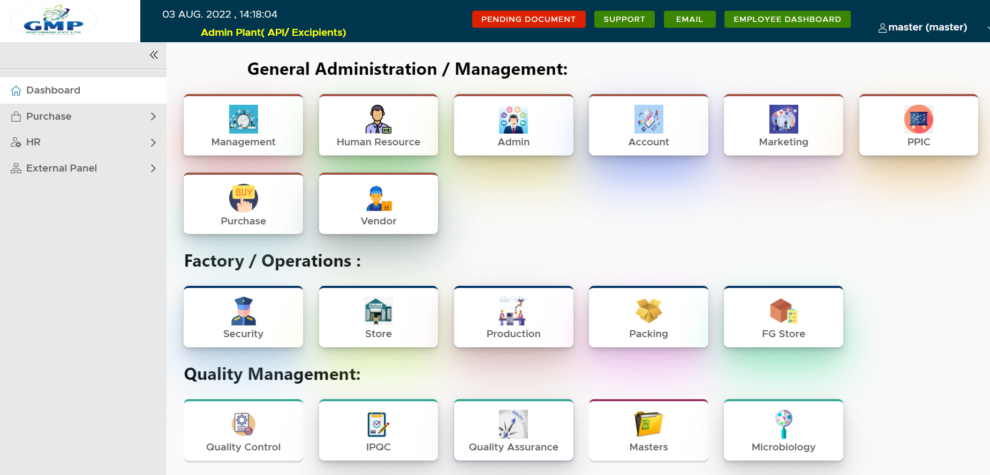
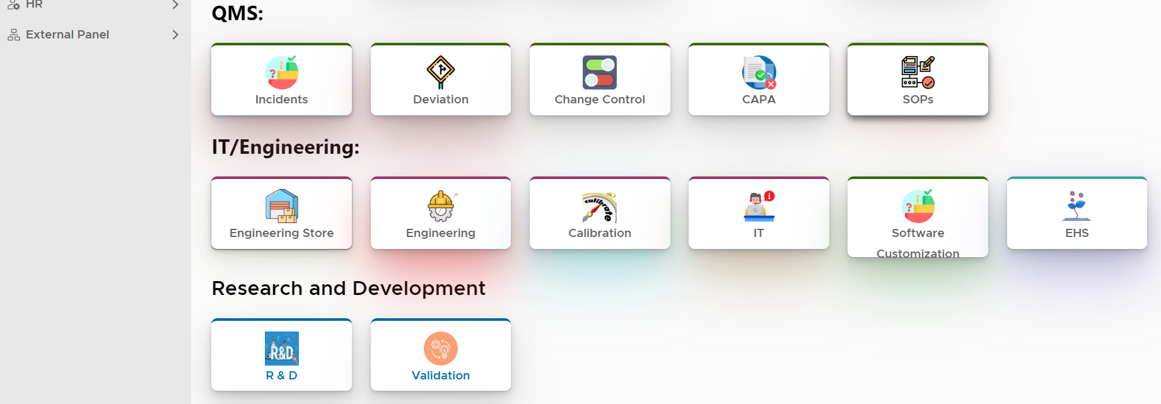
Software Highlights
Place your screenshot here

Slide 9
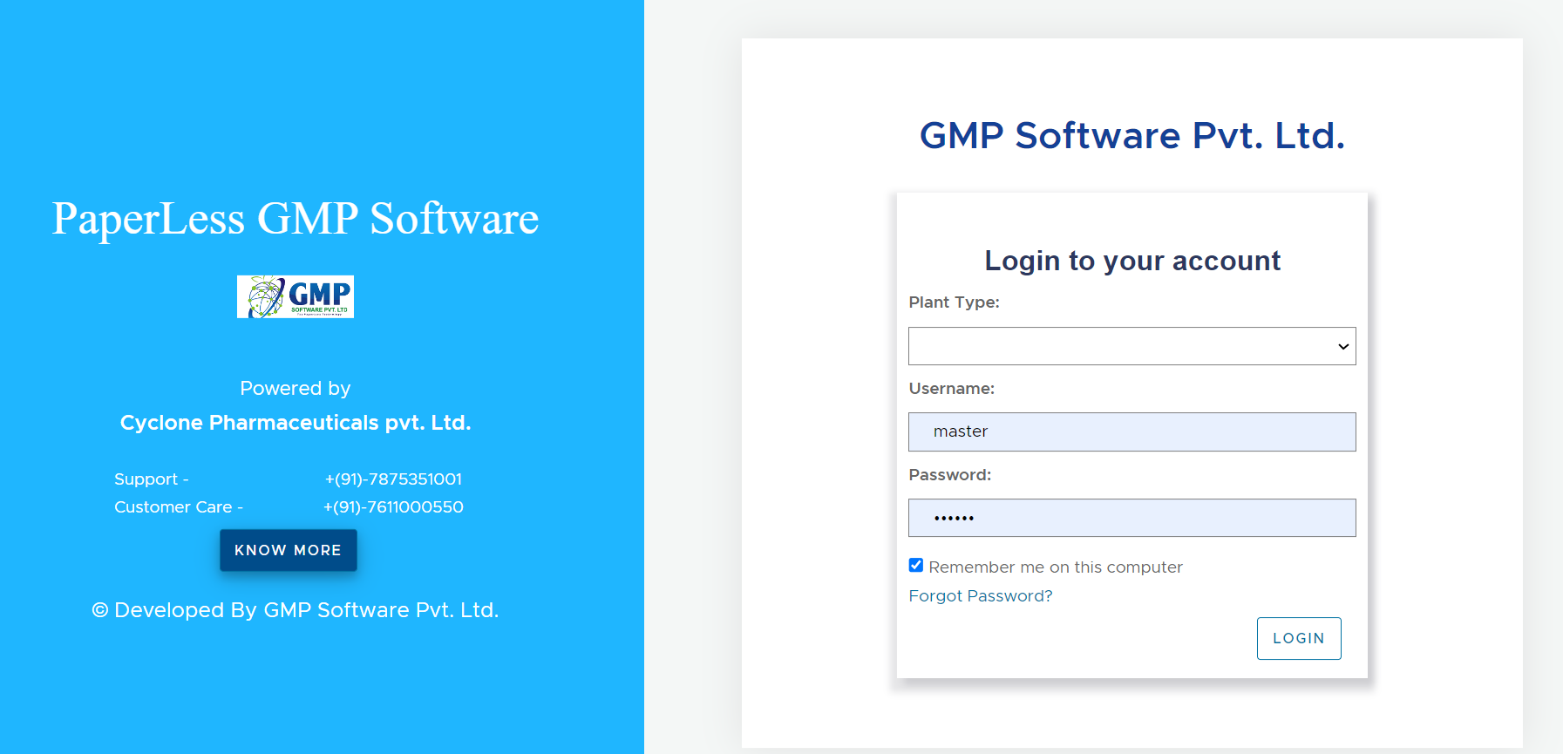
Login Window
Place your screenshot here
Notes:
We have provide department wise access……admin and user login and rights are separate…..

Slide 10
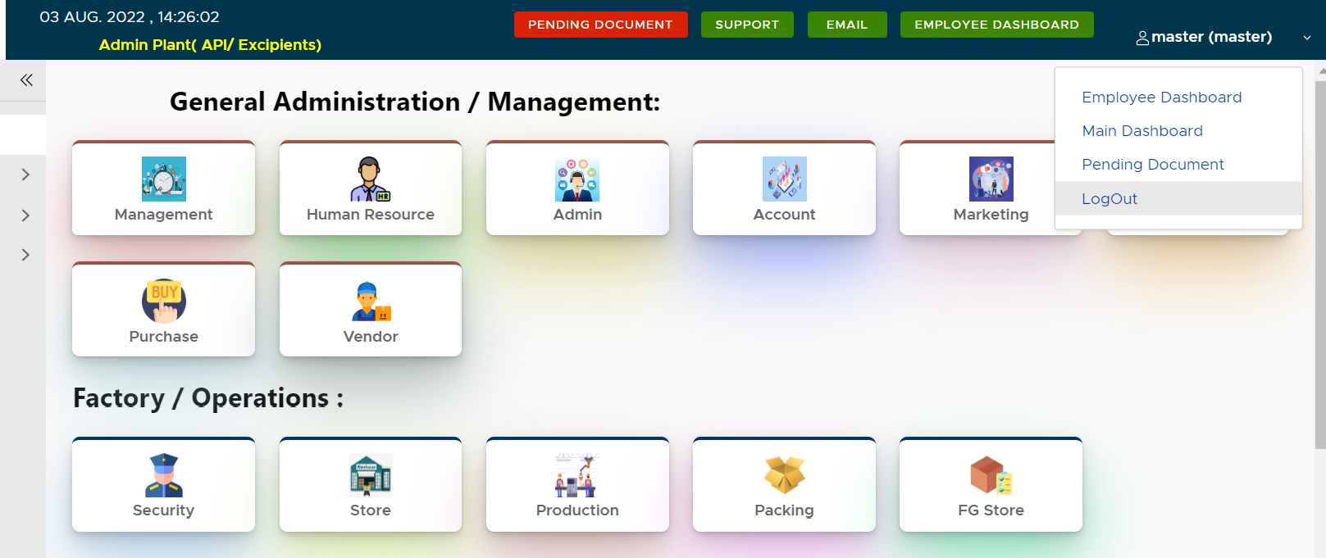
Logout Window
Place your screenshot here

Slide 11
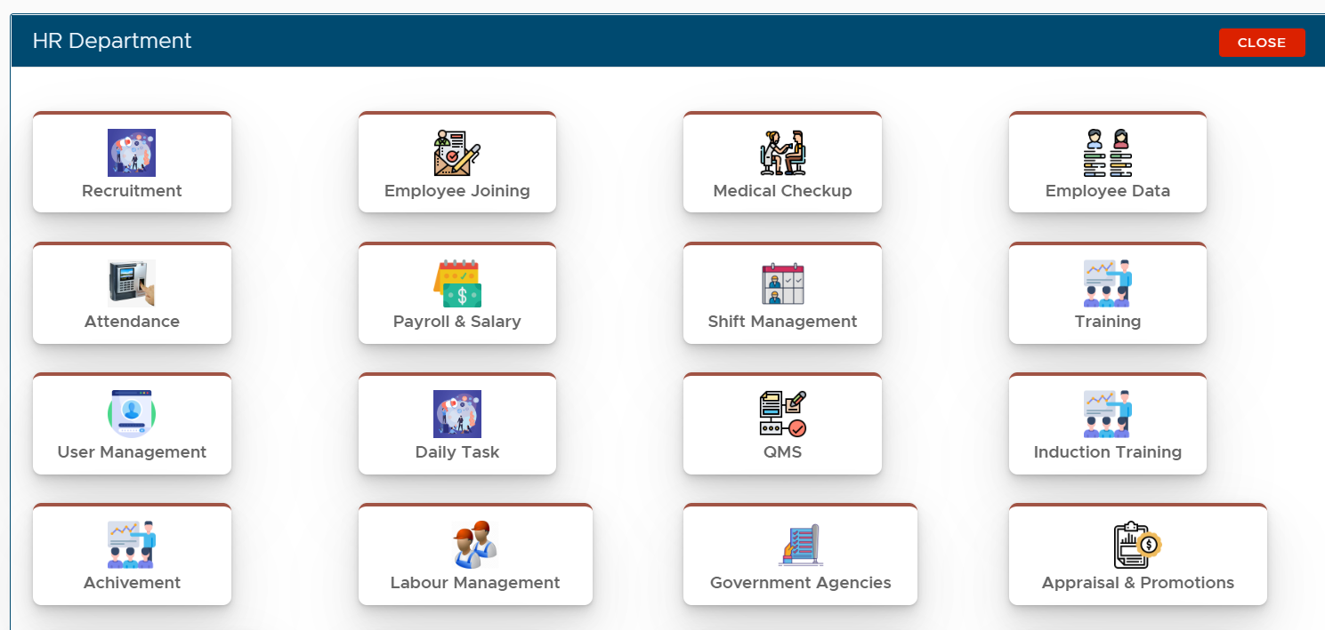
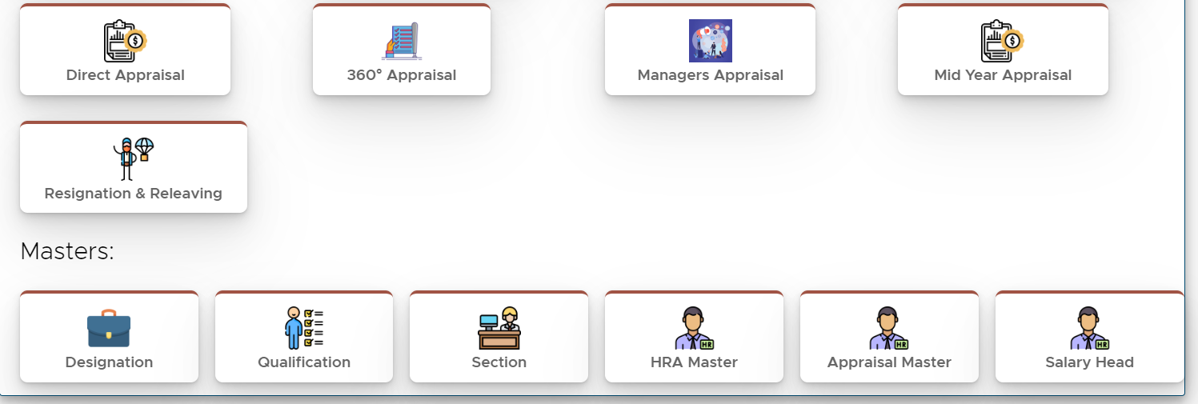
HR & Admin
Recruitment Process
Medical Checkup
Induction, Employee, Labour Training as well
Attendance, Leave, Shift & Salary Management
Resignation, Relieving
Appraisal, Promotions
Notice, User Assignments
Place your screenshot here
Notes:
All the systems involved are software designed to organise all the tasks of emplyee

Slide 12
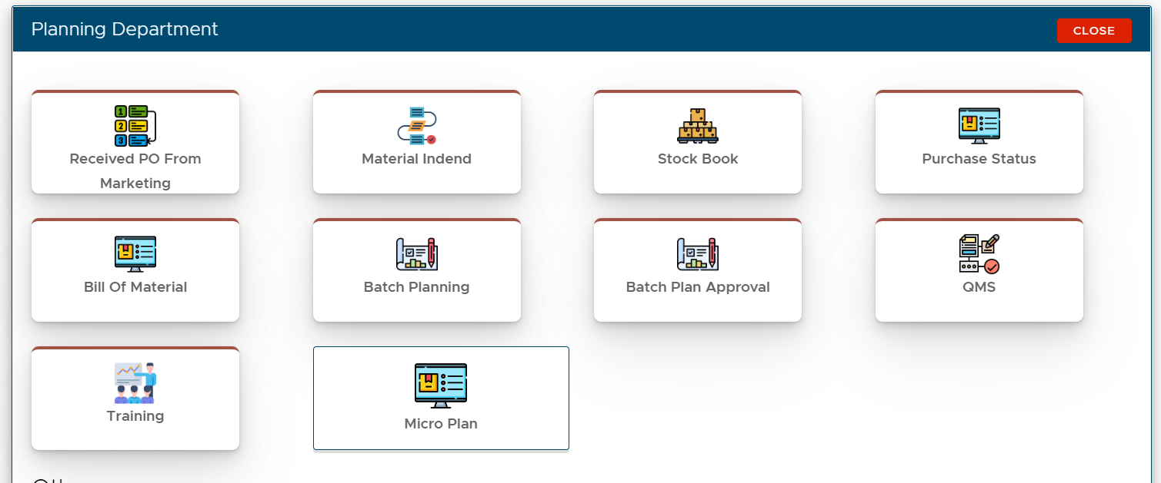
Business Planning
Enquiry/Lead Management
Product Planning
Production Planning
Dispatch Planning
Stock Book
Purchase Planning
Place your screenshot here
Notes:
A business plan is a blue print of step by step process that would be followed to convert business idea into successful business venture…. To monitor the progress after implementing business plan……1.designed and developed to overcome the complications that many businesses face in keeping track of the enquiries or leads that they receive

Slide 13
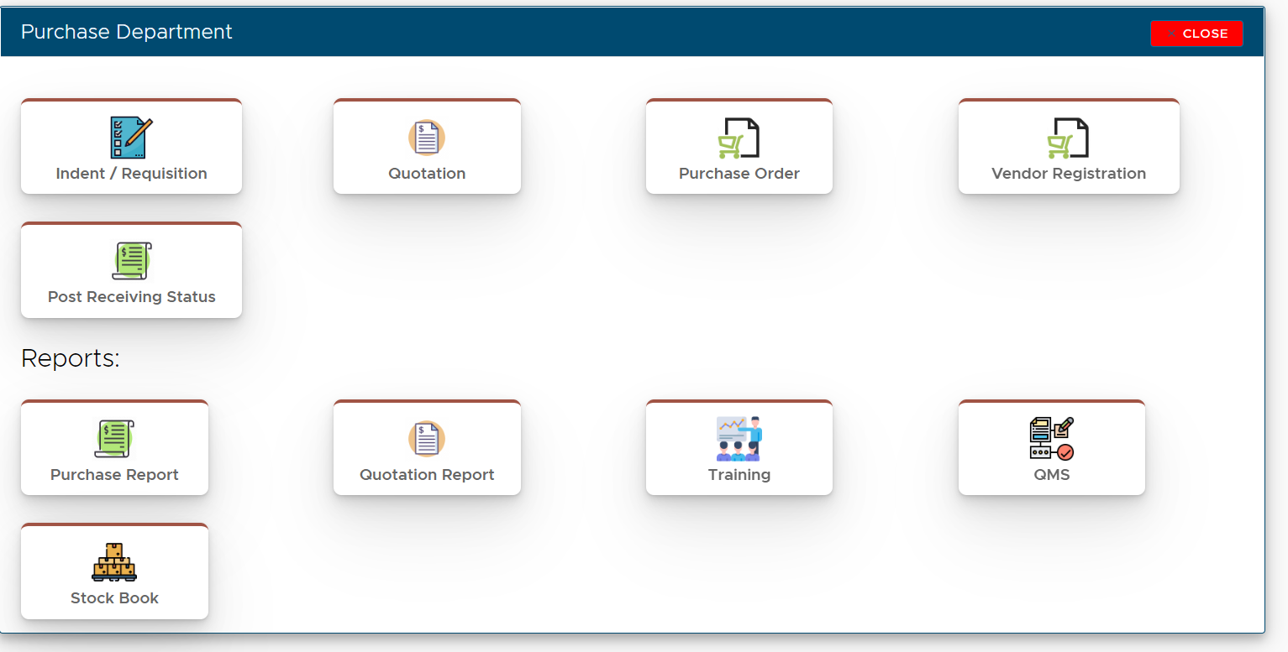
Purchase
Indent, Quotation , Purchase Management
Purchase Reports
Vendor Management
Material Status
Stock Book
Place your screenshot here

Slide 14
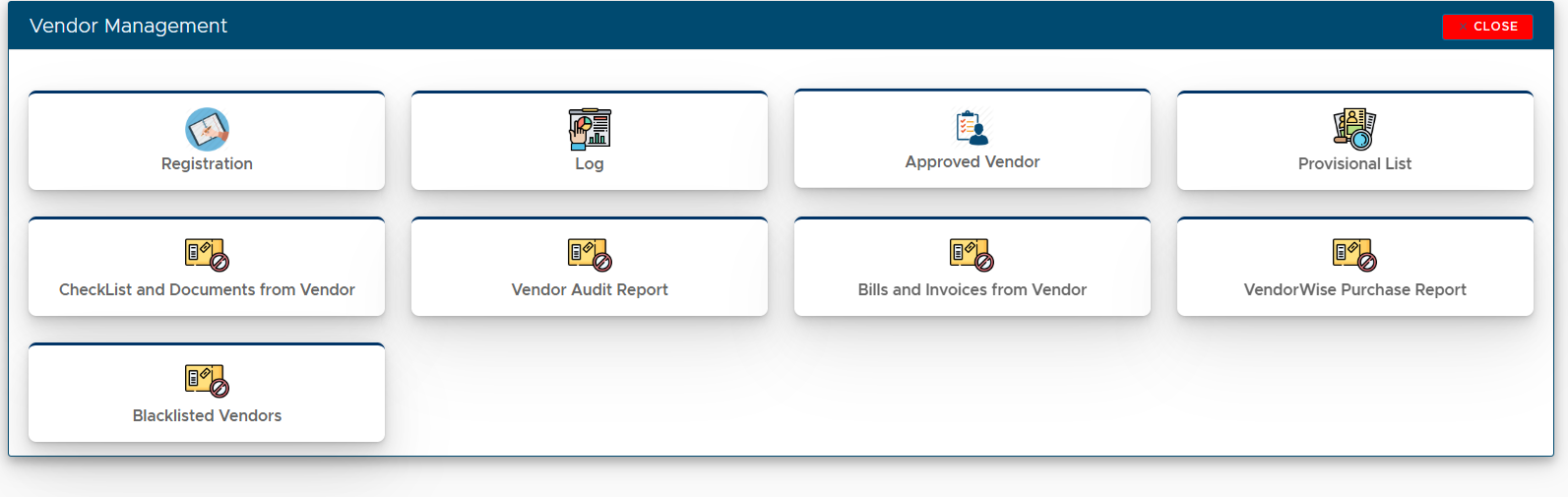
Vendor Management
Vendor Registration
Primary assessment
Sample ands evaluation
Approved of Vendors
Black listing of vendor
Place your screenshot here

Slide 15
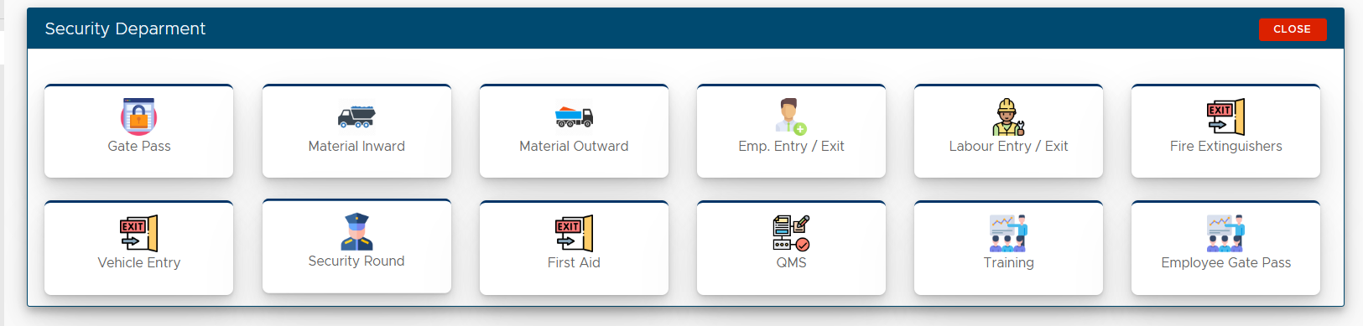
Security
Digital Gate pass
Material Inward-Outward
Employee Entry
Employee Exit
Place your screenshot here

Slide 16
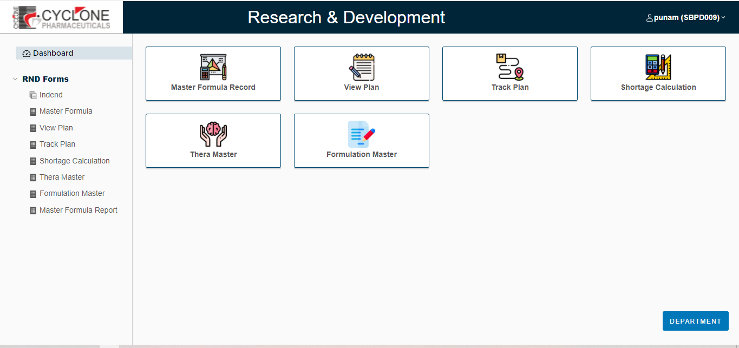
R & D – ( MODULE)
Development Study Initiation
Development Trials
Scale up Study
Stability Management
Development Report
Master Formula Record
Place your screenshot here

Slide 17
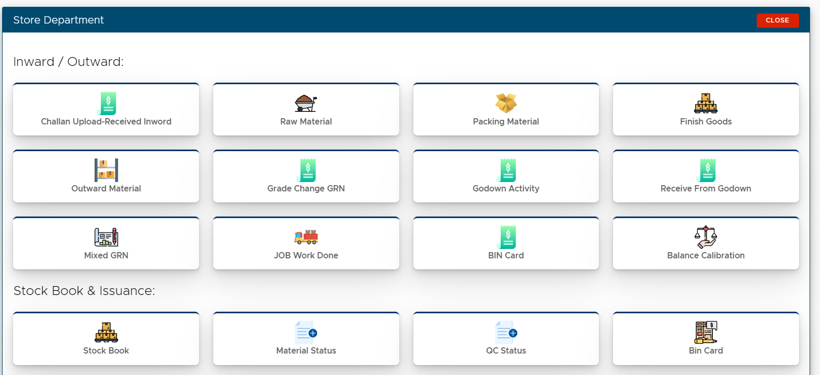
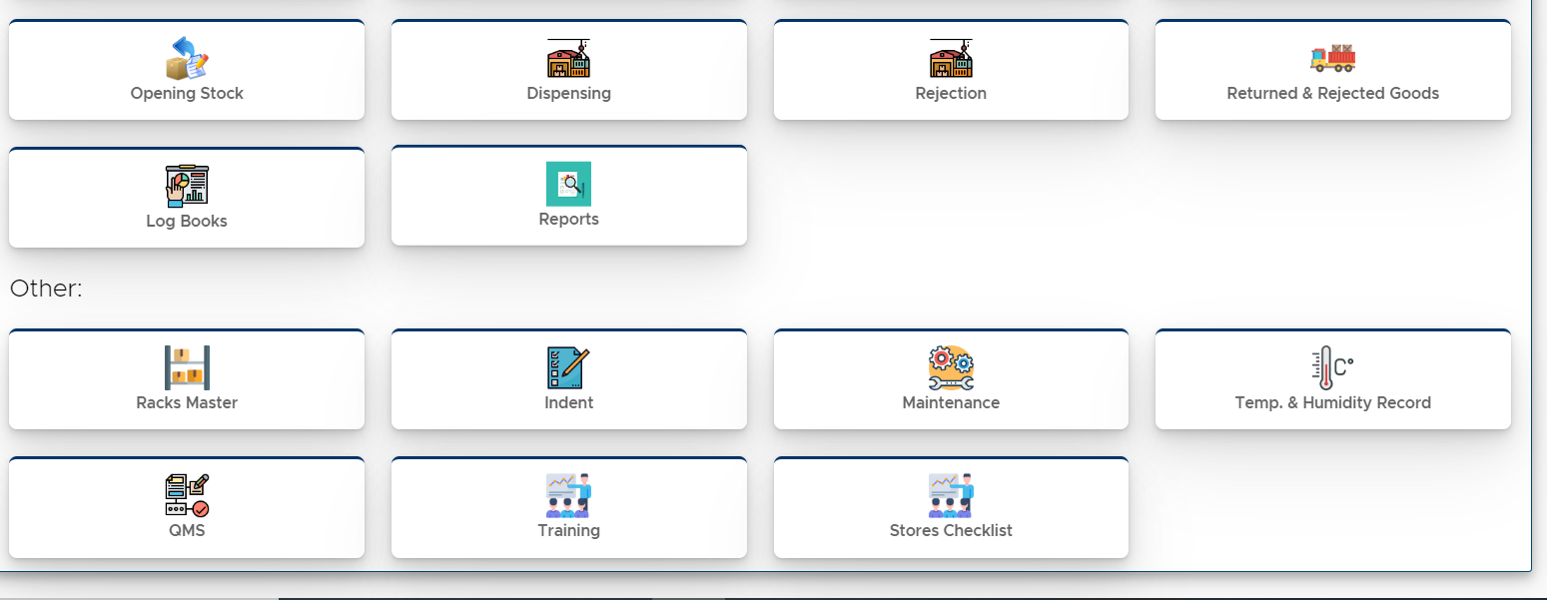
Stores & Inventory Management
Challan Verification
Receiving, Dedusting, Weighing, GRN
Stock book Maintenance
Dispensing
Material Management
Retest, Bincard, Mixed GRN, Grade change GRN, Job Work, Rejection
Place your screenshot here

Slide 18
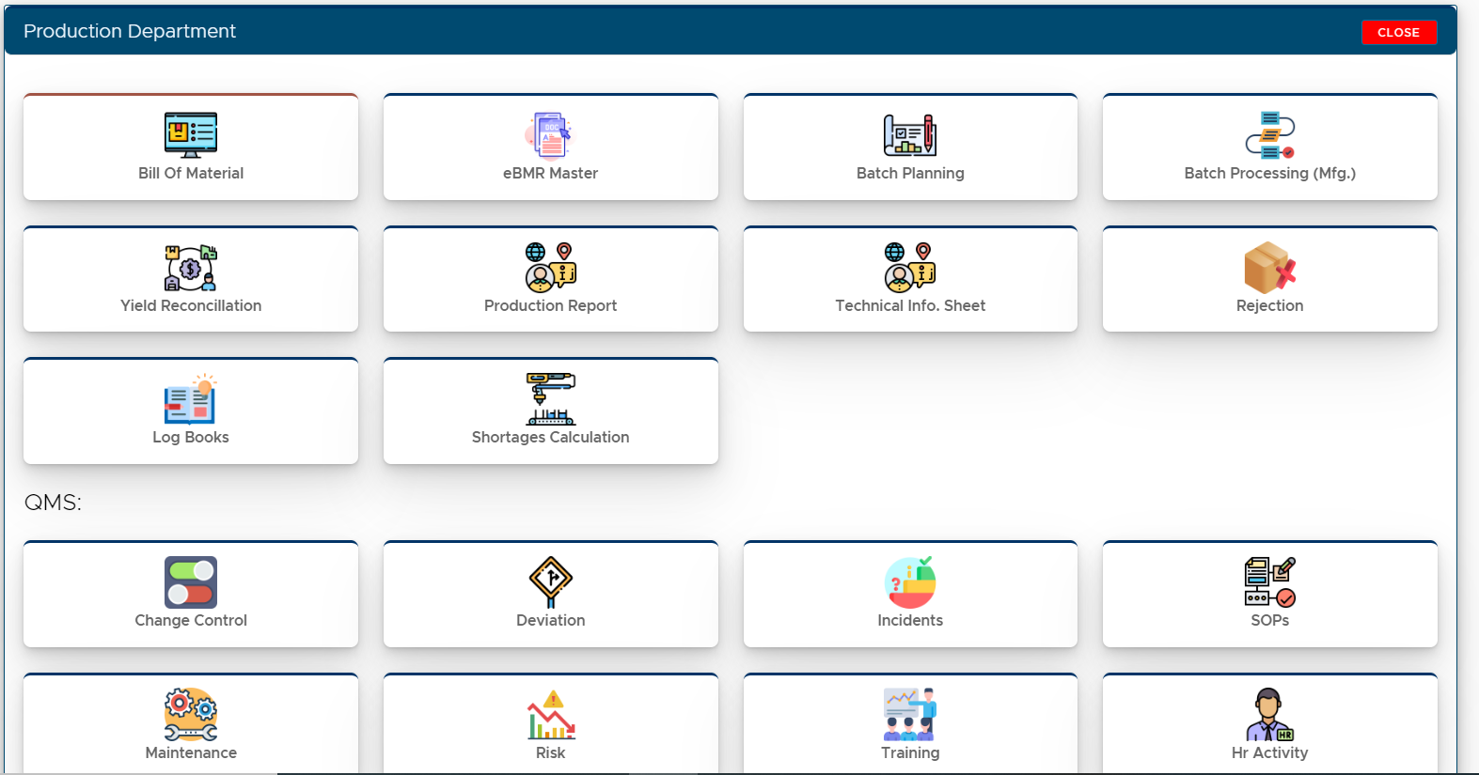
Production
eBMR/BPR/Batch Planning
Bill of Material
Rejection Control
In process Sampling
Yield Management
GMP Monitoring
Maintenance Note
Breakdown Management
Calibration, Qualification
Deviation Change, Incident, Reporting
Place your screenshot here

Slide 19
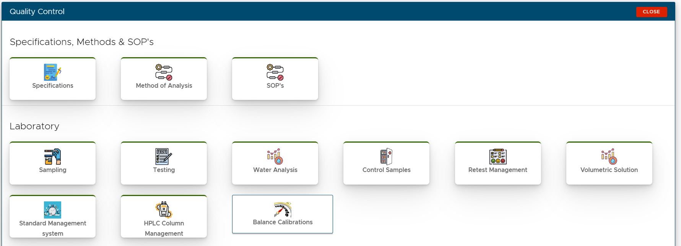
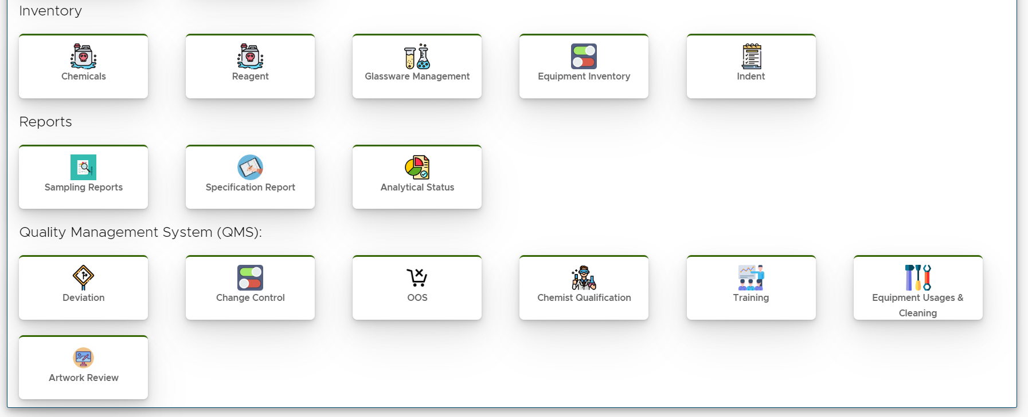
Quality Control
Sampling
Testing/ Raw Data/ Methods Management
COA
Chemicals, Glassware, Equipment Management
Control Sample
Out of Specification
Volumetric Solutions Preparation
Analyst Qualification and Validation
Place your screenshot here

Slide 20
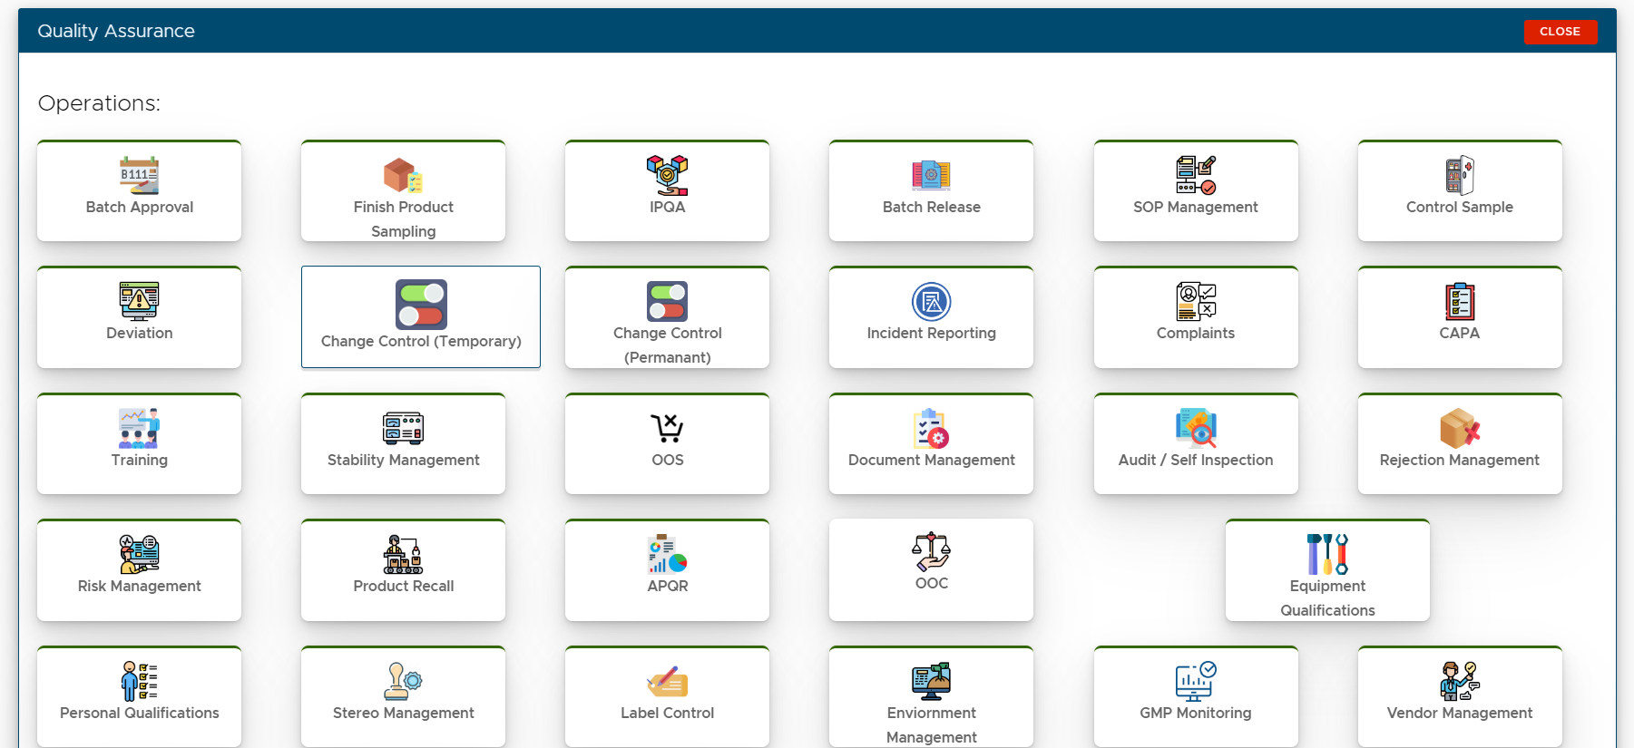
Quality Assurance
Deviation Management
Change Management
Incident Reporting
Batch Release
Training
Self-Inspection
Product Recall
IPQA Monitoring
GMP Inspection
Place your screenshot here

Slide 21
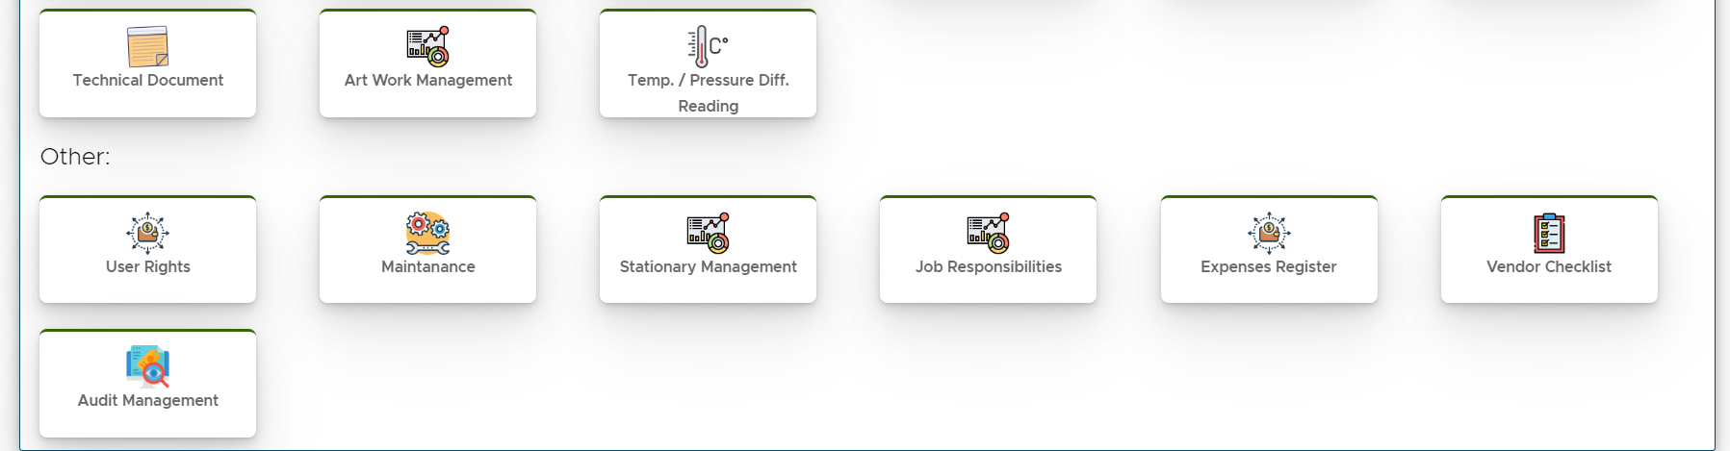
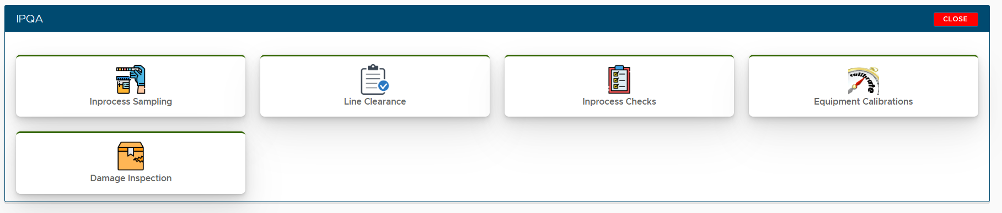
Stability Study Management
Market Complaint
Personal Qualification
Specification, MOA, & Other masters
Sop Management
Documentation Control
QMS Components
APQR
Quality Risk Management (QRM)

Slide 22

Auditors Pannel
All log books and reports
Time charts
Trend Charts
Schedules of Calibration and Validation
eBMR Access
Auditors can put their remakes
Audit Reports
Place your screenshot here

Slide 23
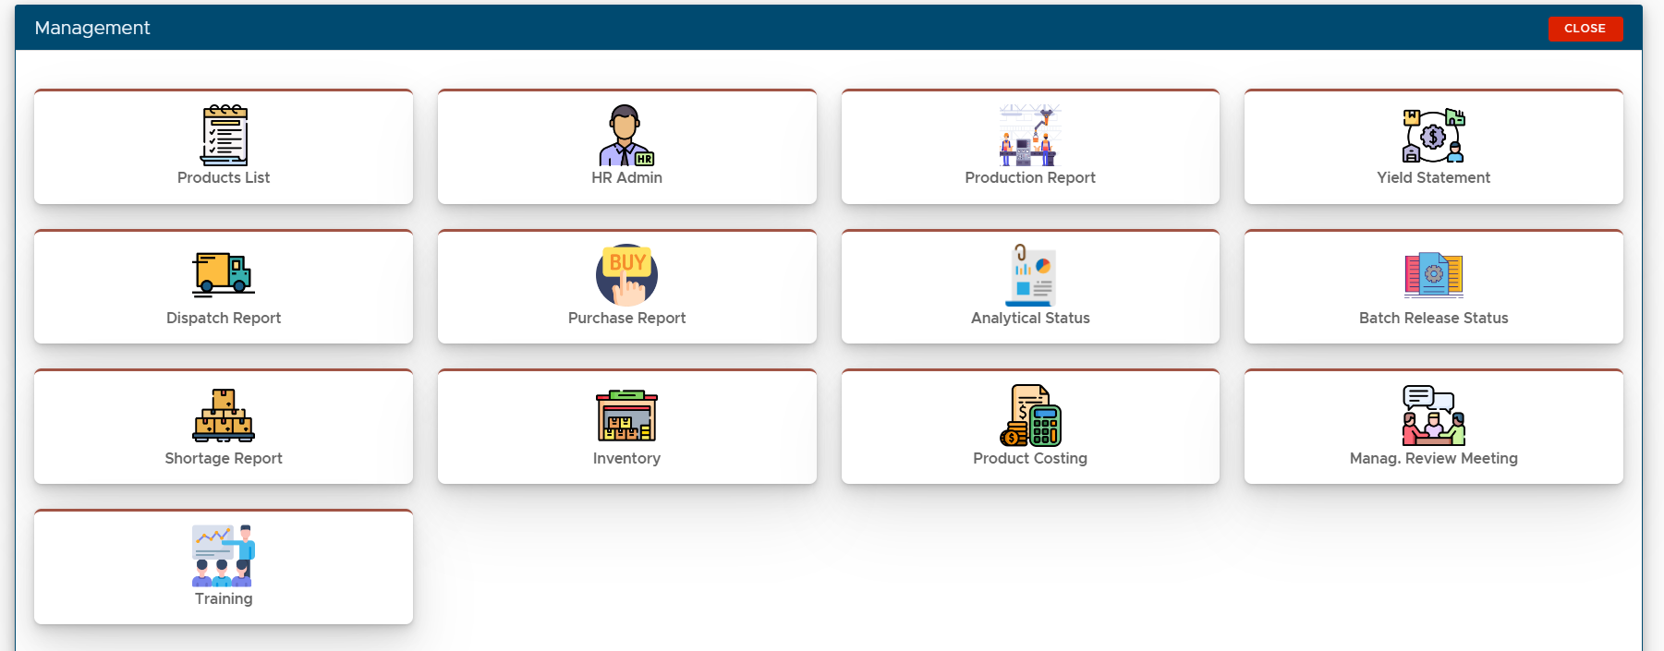
MIS
Daily department Reports
Daily Production Reports
Dispatch and Inventory report
Stock Report
Individual output Analysis
Place your screenshot here

Slide 24
Salient Features
Cost Saving for stationary
Time saving
Manpower Reduction by 30%
Minimum error
Compliance with system & QMS requirement
Zero investment on backup
One click Reports
Track and Trace of all Activities
Control with deviation, incident, Management
Follows all GMP and QMS Concepts
Access Control and Level Management

Slide 25



Cyclone Pharmaceuticals Pvt Ltd.
www.cyclonepharma.com
GMP software pvt. Ltd.
www.gmpsoftwareindi.com
7722000550
7611000550
info@cyclonepharma.com
megha@paperlessgmp.com

Slide 26
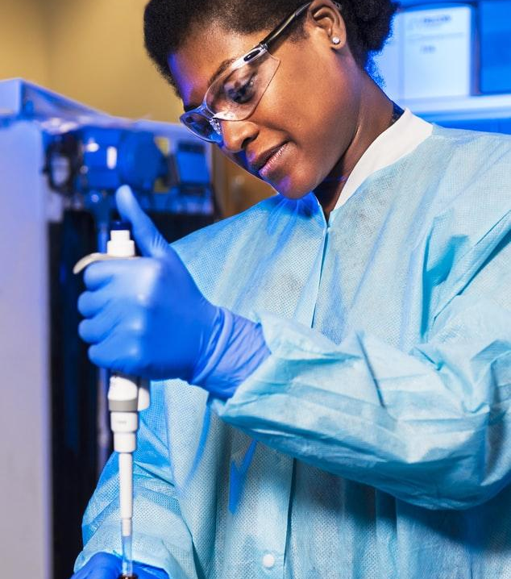
Thanks!

Slide 27
Credits
Special thanks to all the people who made and released these awesome resources :
Team Cyclone pharmaceuticals

