Slide 1
GUDELINES ON COMMON TECHNICAL DOCUMENTS(CTD)

Slide 2
CONTEND:
1. Introduction:
2. Table of contend:
3. Background:
4. Scope:
5 General consideration:
6. Guidelines For Preparation Of CTD:
a. CTD: Overview
b. Module 1: General information
c. Module 2: CTD Summaries
d. Module 3: Quality
e. Module 4: Non-Clinical Study Reports
f. Module 5: Clinical Study Reports
7. Annexure:
Annexure I: Diagrammatic representation of CTD
Annexure II: Format for undertaking or declaration
Annexure III: Format for listing of clinical studies

Slide 3
INTRODUCTION:
Common Technical Document(CTD):
1. It is a set of specification for application dossier for the registration of medicine.
2. Demonstration of safety and efficacy of the drug product for use in humans is essential before the drug product can be approved for import or manufacturing of new drug by the applicant by Central Drugs Standard Control Organization (CDSCO).
3. Through the International Conference on Harmonization (ICH) process, the Common Technical Document (CTD) guidance’s have been developed for Japan, European Union, and United States.

Slide 4
SCOPE:
1. This guideline applies to import / manufacture and marketing approval of new drugs including New chemical entity, new indication, new dosage forms, modified release form, new route of administration etc.
2. This guideline is not intended to advice on the design of studies that are required for product registration, but, indicates an appropriate format for submission of the data that have been acquired.
3. Drugs & Cosmetics Act and Rules there under, defines the ‘content requirements’ for the specific type of submission and hence, this guidance document has to be read along with Drugs and Cosmetics Act 1940 and Rules made thereunder.

Slide 5
General consideration:
The CTD is only a format for submission of information to CDSCO. It does not define the content
Clear and unequivocal information should be provided
Text and tables should be prepared using margins that allow the document to be printed clearly without losing any information and the left-hand margin should be sufficiently large so that information is not obscured by the method of binding.
The Font Size type should be Times New Roman, 12-point font is recommended for descriptive text and Times New Roman, 9 to 10-point font for table contents and text.
All abbreviations should be defined at the first instance they are used and listed at the end of the dossier
Please submit ONE hard copy and THREE soft copies i.e. Compact Disc (CD) (PDF format) of the dossier

Slide 6
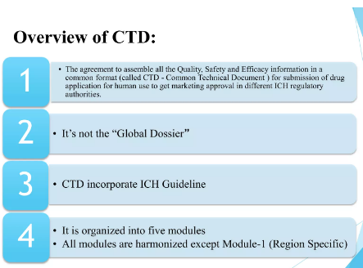
Guidelines for preparation of CTD:

Slide 7
MODULE I:
General Information:
Module I:
This module should contain documents specific to India; for example, Form 44, Treasury challan fee or the proposed label for use in India.

