Slide 1
Global submission of ind,nda,anda

Slide 2
CONTENT:
IND-Introduction
IND chart
Format and content of IND
Types of IND’S
NDA-Introduction
Format and content of NDA
General requirements for filing NDA
NDA chart
AND-Introduction
Format and content of ANDA
ANDA chart
Conclusion
Reference

Slide 3
INVESTIGATIONAL NEW DRUG(IND):
IND under 21 CFR 312.3 (B) as “A new drug or biological drug that is used in clinical investigation”.
The investigational new drug application is a request for an exemption from the federal status that prohibits an unapproved drug from being shipped in interstate commerce.
Once IND application is submitted the sponsor must wait for 30 days before initiating any clinical trail.

Slide 4
The sponsor submits the application for conduct of human clinical trials called IND application to FDA.
Once IND application is submitted ,the sponsor must wait for 30 days before initiating any clinical trial.
Clinical trials in humans can begin only after IND is reviewed by the FDA and a local institutional review board.
IF the FDA accepts the IND request within 30 days of submission ,clinical testing of new molecule on human may begin by the investigator.
If at anytime during clinical testing , the data furnished to FDA indicate the IP to be toxic under criteria of FDA’s benefit ,FDA can terminate clinical trial and its actions are not subject to any judicial review.

Slide 5
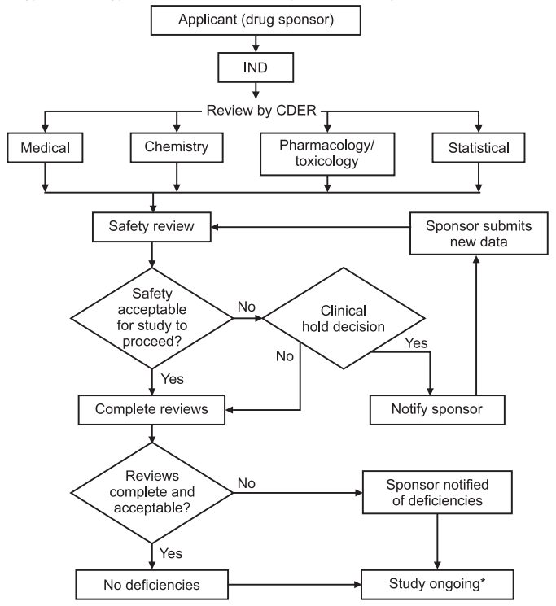
IND CHART

Slide 6
FORMAT AND CONTENT OF IND:
Cover sheet (form FDA 1571).
A table of contents.
Introductory statement and general investigational plan.
Investigator’s brochure.
Protocols.
Chemistry, manufacturing and control information.
Previous human experience with IP.
Additional information.

Slide 7
TYPES OF IND’S:
[A]COMMERCIAL IND’S:
These are applications that are submitted primarily by companies to obtain marketing approval for a new product.
[B]NON-COMMERCIAL IND:
These IND’s are filed for non –commercials research.
Types of non- commercial IND:-
Investigator’s IND.
Emergency use IND.
Treatment IND

Slide 8
NEW DRUG APPLICATION:
The new drug application is the vehicle through which the drug sponsors formally propose FDA or DCGI to approve a new investigational drug for scale and marketing after phase 3A pivot trials.
Official definition of NEW DRUG according to sec 201 (p) of federal drug ,food and cosmetics act:-
“Any drug the composition of which is such that it is not recognized among experts qualified by scientific training as safe and effective for use under prescribed ,recommended or suggested”.

Slide 9
FORMAT AND CONTENT OF NDA:
The application is required to be submitted in common technical document format with the following different format:-
FDA form 356 h.
User fee cover sheet (FDA form 3397).
Cover letter.
Summary.
Chemistry ,manufacturing and control.
Samples, method validation, package and labeling.
Non clinical pharmacology and toxicology.
Human pharmacokinetics and bioavailability.
Microbiology.
Statistical methods and analysis of clinical data.
Safety update report.

Slide 10
Statement regarding compliance to IRB and informed consent requirement.
Case report tabulations.
Case report forms.
Patent information and certification.
Other information.

Slide 11
GENERAL REQUIREMENTS FOR FILING NDA:
The new NDA regulations require the application to be submitted in 2 copies:-
[A] AN ARCHIVAL COPY: It is a complete copy of application submission that serves as its permanent record.
[B] A REVIEW COPY: It is divided into 6 technical sections
1- chemistry ,manufacturing and controls.
2-Non clinical pharmacology and toxicology.
3-Human pharmacokinetics and bioavailability.
4-Microbiology
5-Clinical data
6-Statistical

Slide 12
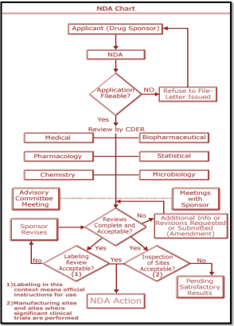
NDA CHART

Slide 13
On receipt of NDA ,the CDER stamps with a receipt data to enable FDA to forward action within 180 days called ‘REVIEW CLOCK’ under REVIEW TIME FRAMES (21 CFR 314.100).
The FDA assign the application for review.
The FDA has to intimate the applicant if it is incomplete within 60 days according to Filing Time Frames(21 CFR 314.101).
FDA notifies the sponsor of its completion /incompletion.
FDA inspects the manufacturing facilities for the drug ,it may also inspect sample of clinical trial locations to verify the accuracy of data submitted.
Once all reviews are complete the divisional director evaluates the reviews and make FDA’s decision

Slide 14
ABBREVIATED NEW DRUG APPLICATION (ANDA):
Generic drug applications are referred to ANDA.
Generic drug are termed ‘ABBREVIATED’ as they are not required to include preclinical and clinical data to establish safety and efficiency.
They must scientifically demonstrate bioequivalence to innovator drug.
Use of bioequivalence as base for approving generic drug products was established in 1984 also known as ‘WAXMAN-HATCH ACT ‘.
It is because of this act that generic drugs are cheaper without conducting costly and duplicate clinical trials

Slide 15
FORMAT AND CONTENT OF ANDA
3 copies of the abbreviated application are required to be submitted, an archival copy, a review copy and a field copy.
ARCHIVAL COPY-
Application form
Table of contents.
Basis for ANDA submission.
Condition of use.
Active ingredients.
Route of administration.
Dosage form and strength.
Bioequivalence and bioavailability .
Labeling.
Chemistry , manufacturing and control.
Samples.
Patent certificates.
Financial certificates or disclosure statement.
Other information.

Slide 16
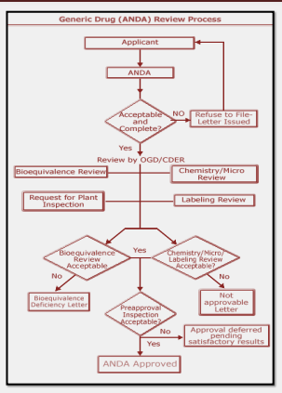
ANDA CHART

Slide 17
SUMMARY:
The Drug approvals in the US, Europe & India are the most demanding in the world. The primary purpose of the rules governing medicinal products in US, Europe & India is to safeguard public health. It is the role of public regulatory authorities to ensure that pharmaceutical companies comply with regulations.
Developing a new drug requires great amount of research work in chemistry, manufacturing, controls, preclinical science and clinical trials. Drug reviewers in regulatory agencies around the world bear the responsibility of evaluating whether the research data support the safety, effectiveness and quality control of a new drug product to serve the public health.

Slide 18


